Slide 1

ELK Stack
Introduction to Elasticsearch, Logstash and Kibana
github.com/phucnguyenvn

Slide 2
Agenda
The story
ELK Stack
Elasticseach
Logstash
Kibana
Demo

Slide 3











The story
Log
Log
Log
Log
Log
Log
Log
Log
Log

Slide 4
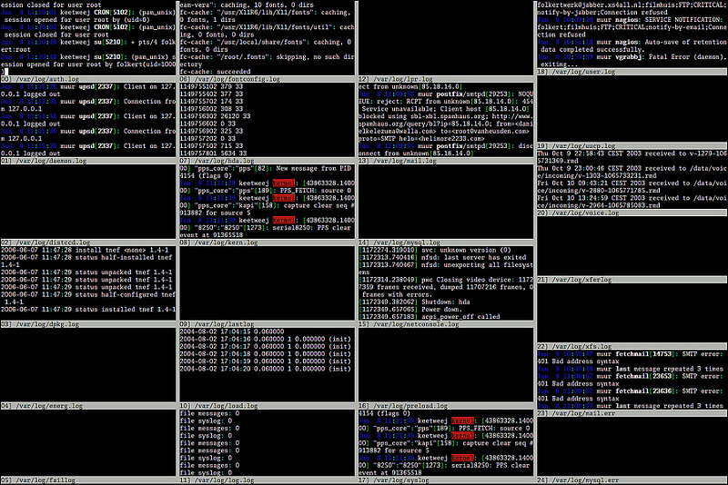
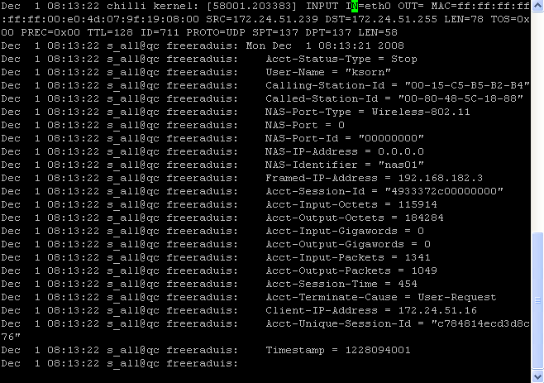
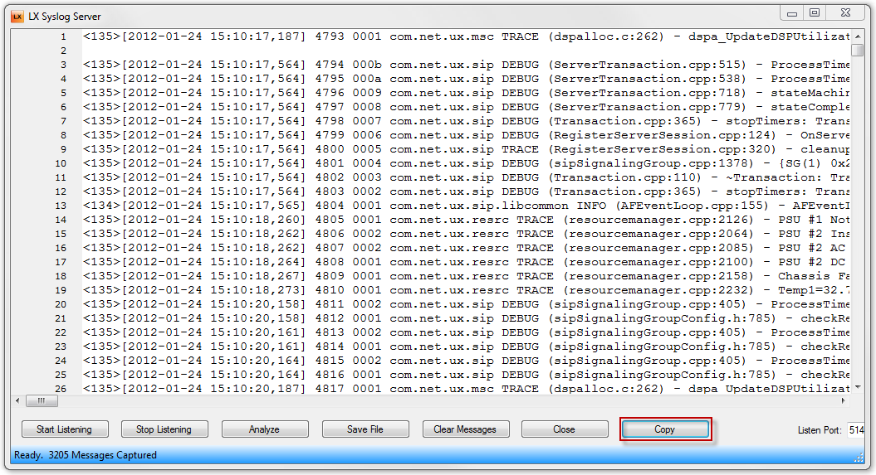
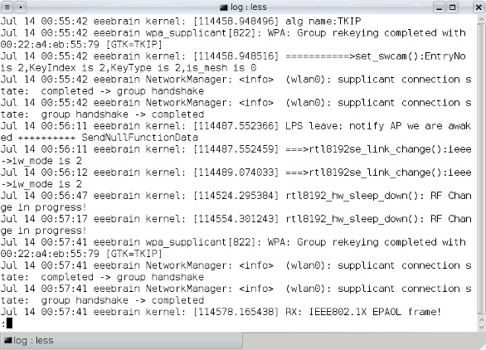
The story

Slide 5

The story
“Can you check the errors from yesterday between 15.02 and 15.07 ?!”

Slide 6

The story
“Can you check the errors from yesterday between 15.02 and 15.07 ?!”

Slide 7
SOLUTION
The story
Visualization > Plaintext

Slide 8
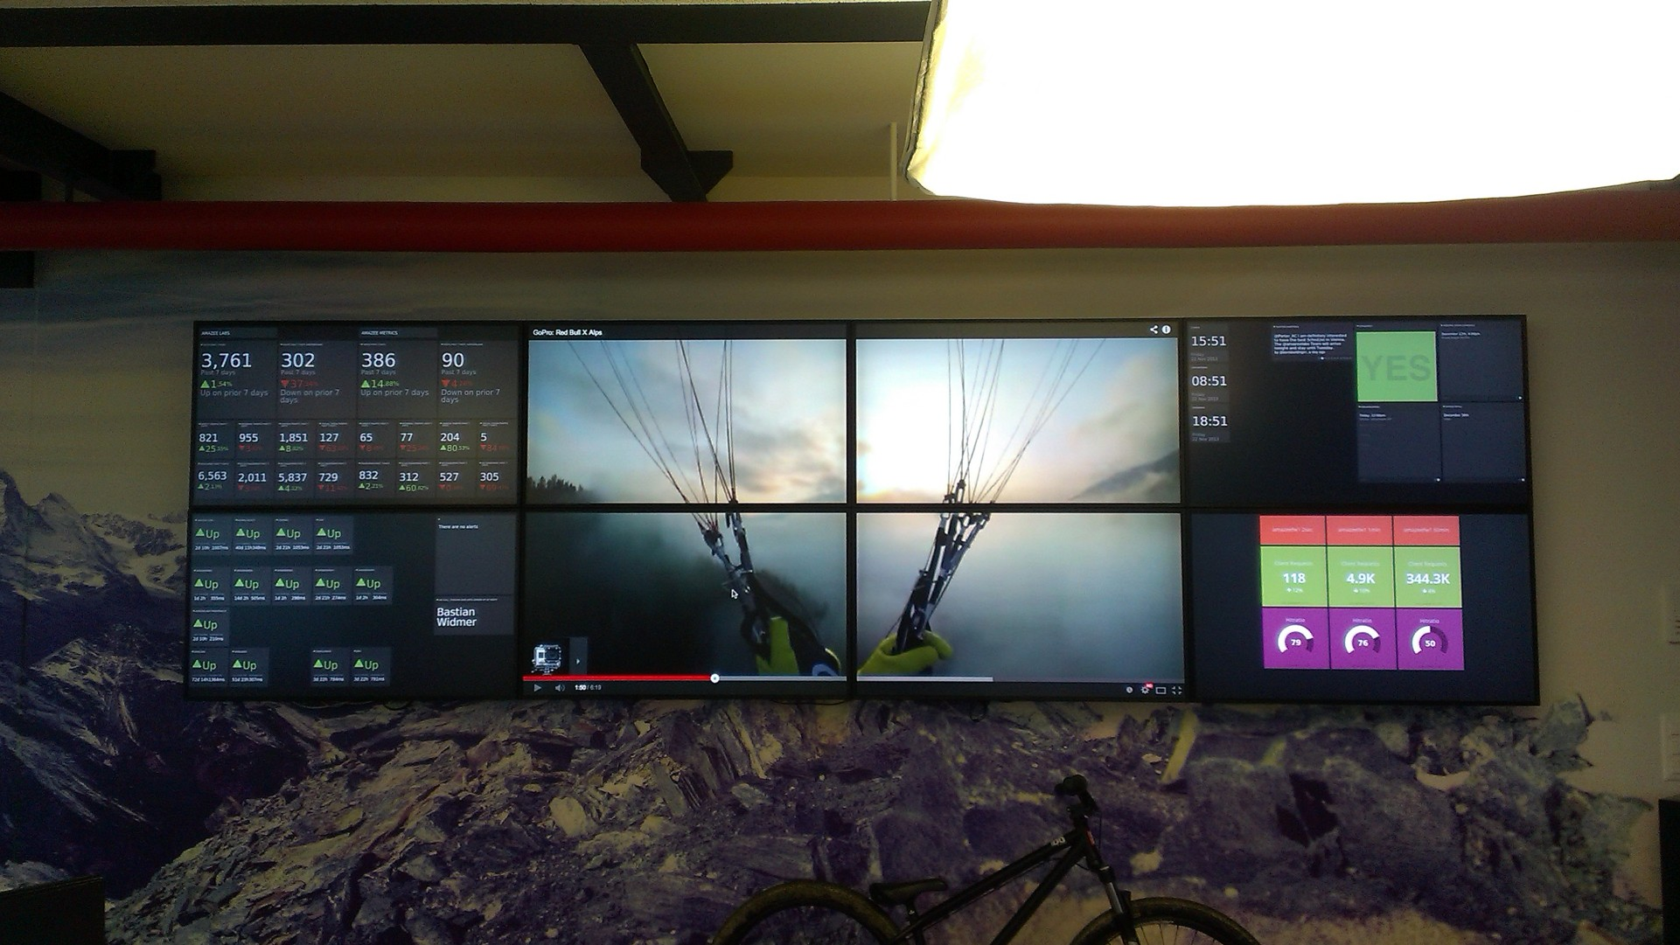
The story

Slide 9
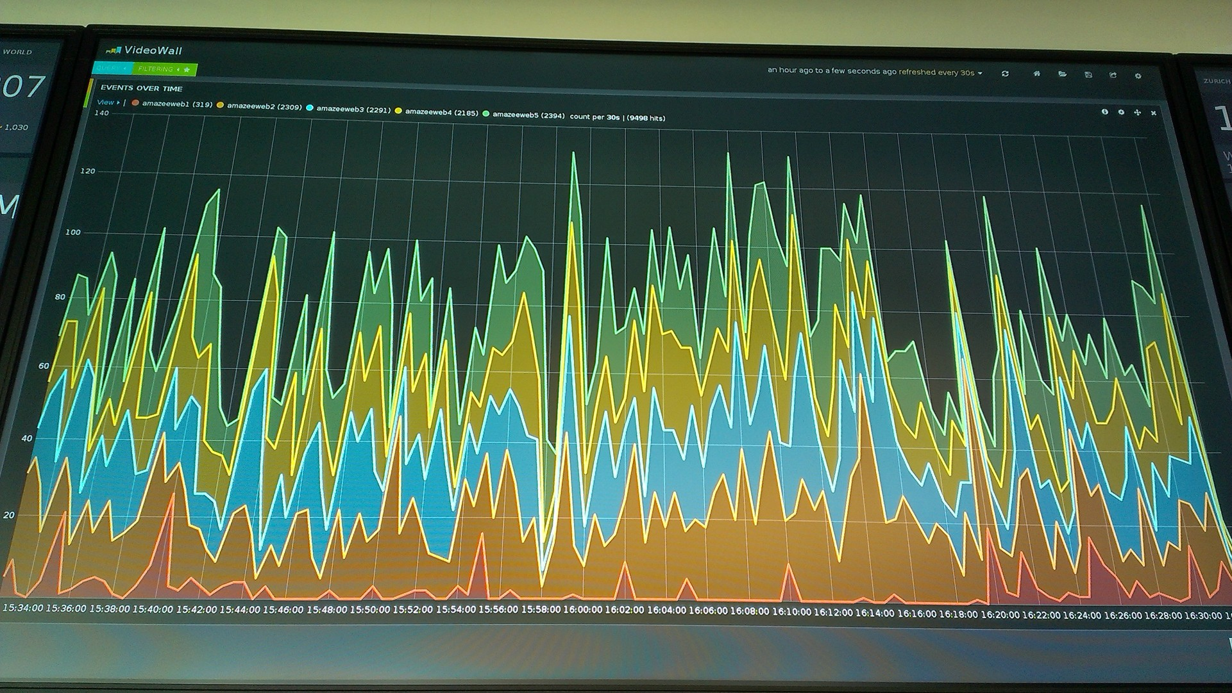
The story

Slide 10

ELK Stack
The ELK Stack is a collection of three open-source products:
Elasticsearch, Logstash, and Kibana — from Elastic.

Slide 11
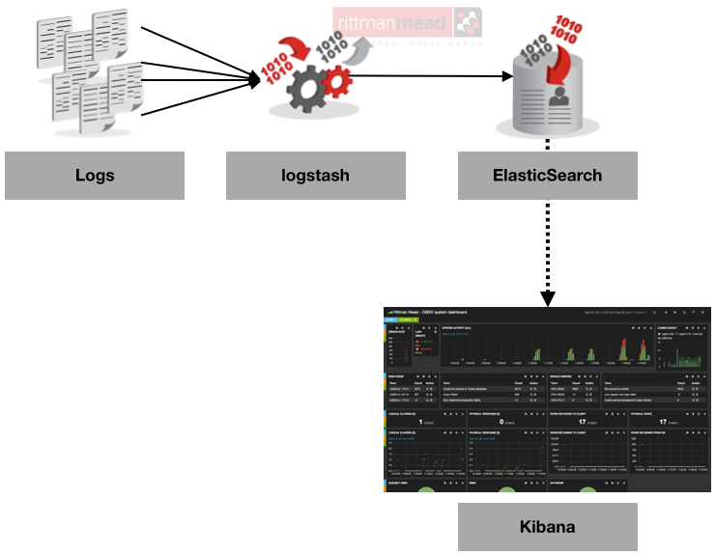
ELK Stack

Slide 12
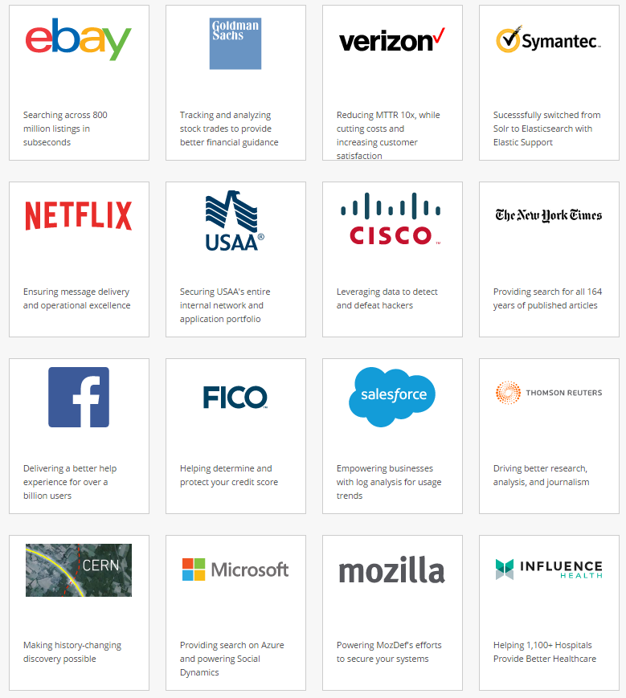
ELK Stack

Slide 13
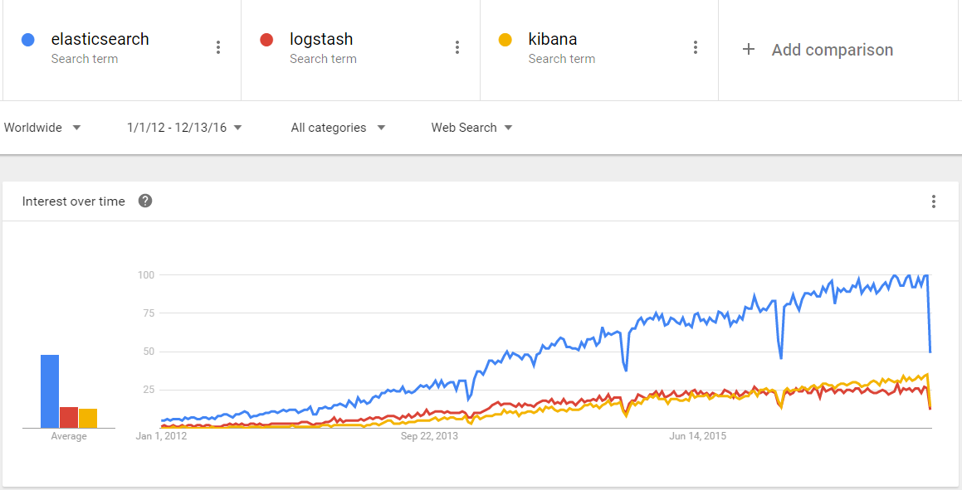
ELK Stack

Slide 14

Elasticsearch
SELECT * FROM `liv-dev`
WHERE `name` LIKE ‘%phuc%’

Slide 15
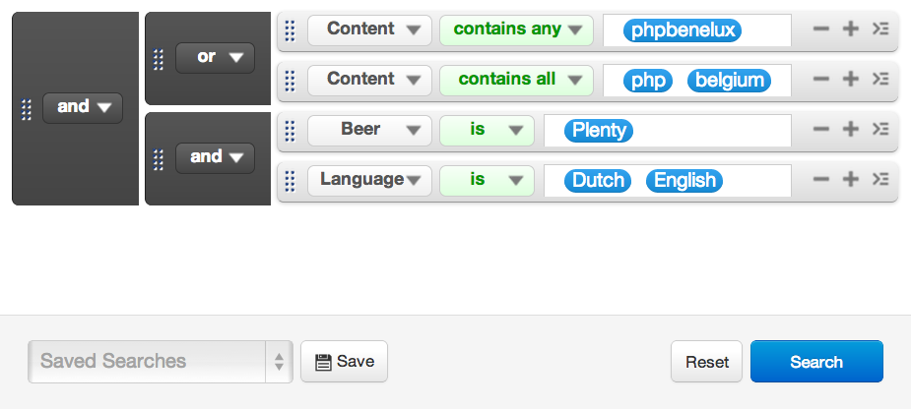
Elasticsearch
Notes:
But search can go deeper and more into detail too ..
Here I’m using
AND, OR, NOT
Nesting
Restrictions on fields

Slide 16
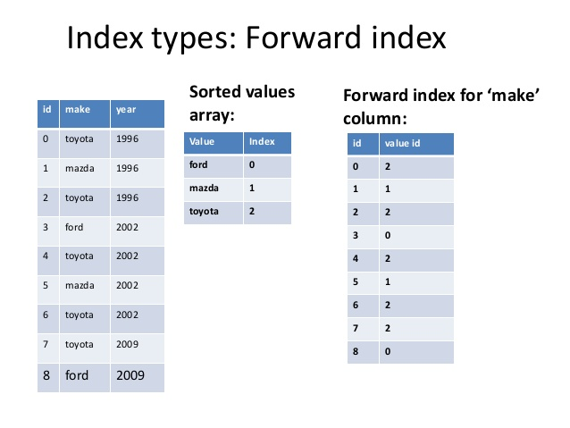
Elasticsearch

Slide 17

Notes:
And the library analogy for a MySQL index is this …
An index card box.

Slide 18

Notes:
Problems arise when you have lots of data …
To speed things up you add indeces to your MySQL tables.

Slide 19
Elasticsearch
SELECT * FROM `liv-dev` j
JOIN jobs_benefits jb ON j.id = jb.job_id
WHERE j.role = ‘DEVELOPER’
AND (MATCH(job_description) AGAINST (‘node.js -asp’ IN BOOLEAN MODE)
AND jb.free_coffee = TRUE

Slide 20

Notes:
Or very difficult …
Searching in a mixed set of data
Profiles
Photos
Friend connections
Searching in a graph …

Slide 21

Elasticsearch
Apache lucene
“Information retrieval software library”
Free/open source
Supported by Apache Foundation
Created by Doug Cutting
Written in 1999

Slide 22
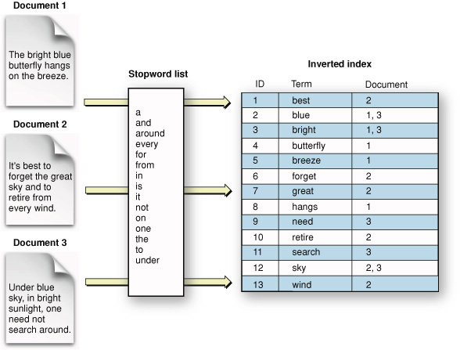
Elasticsearch

Slide 23
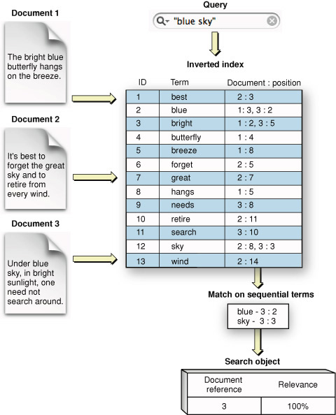
Elasticsearch

Slide 24
Elasticsearch
• Open source search server written in Java
•Used to index any kind of heterogeneous data
•Enables real-time ability to search through index
•Has REST API web-interface with JSON output

Slide 25
Elasticsearch
RESTfull Service
JSON API over HTTP
Want to use it from PHP?
CURL Requests, as if you’d do requests to the Facebook Graph API.
High Availability & Performance
Clustering
Long Term Persistency
Write through to persistent storage system.

Slide 26
Elasticsearch
Based on top Lucence
Multi-language support
Geolocation support
Full-text search
Did-you-mean suggestions
Extremely speed
Support RESTful
Text and number
Scoring

Slide 27
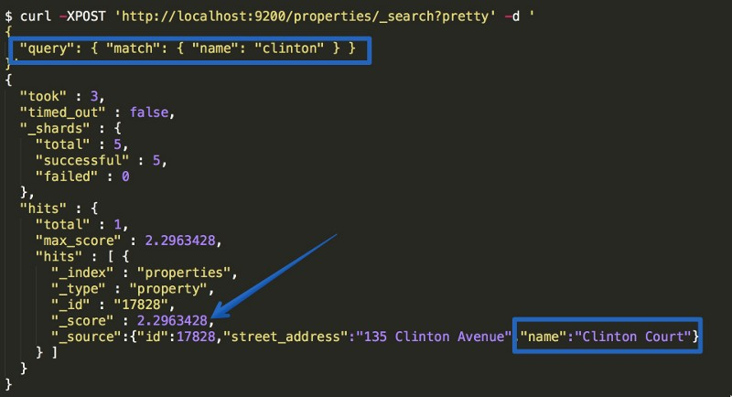
Elasticsearch

Slide 28
Elasticsearch
Terminology:
MySQL | Elastic Search
Database | Index
Table | Type
Row | Document
Column | Field
Schema | Mapping
Index | Everything is indexed
SQL | Query DSL
SELECT * FROM table … | GET http://…
UPDATE table SET … | PUT http://…

Slide 29

Logstash
•Framework for managing logs
•Founded by Jordan Sissel
•Mainly consists of 3 components:
input : passing logs to process them into machine understandable format(file,lumberjack).
filters: set of conditionals to perform specific action on a event(grok,geoip).
output: decision maker for processed event/log(elasticsearch,file)

Slide 30
Logstash
Multiple Input / Multiple Output
Centralize Logs
Collect
Parse
Store / Forward

Slide 31
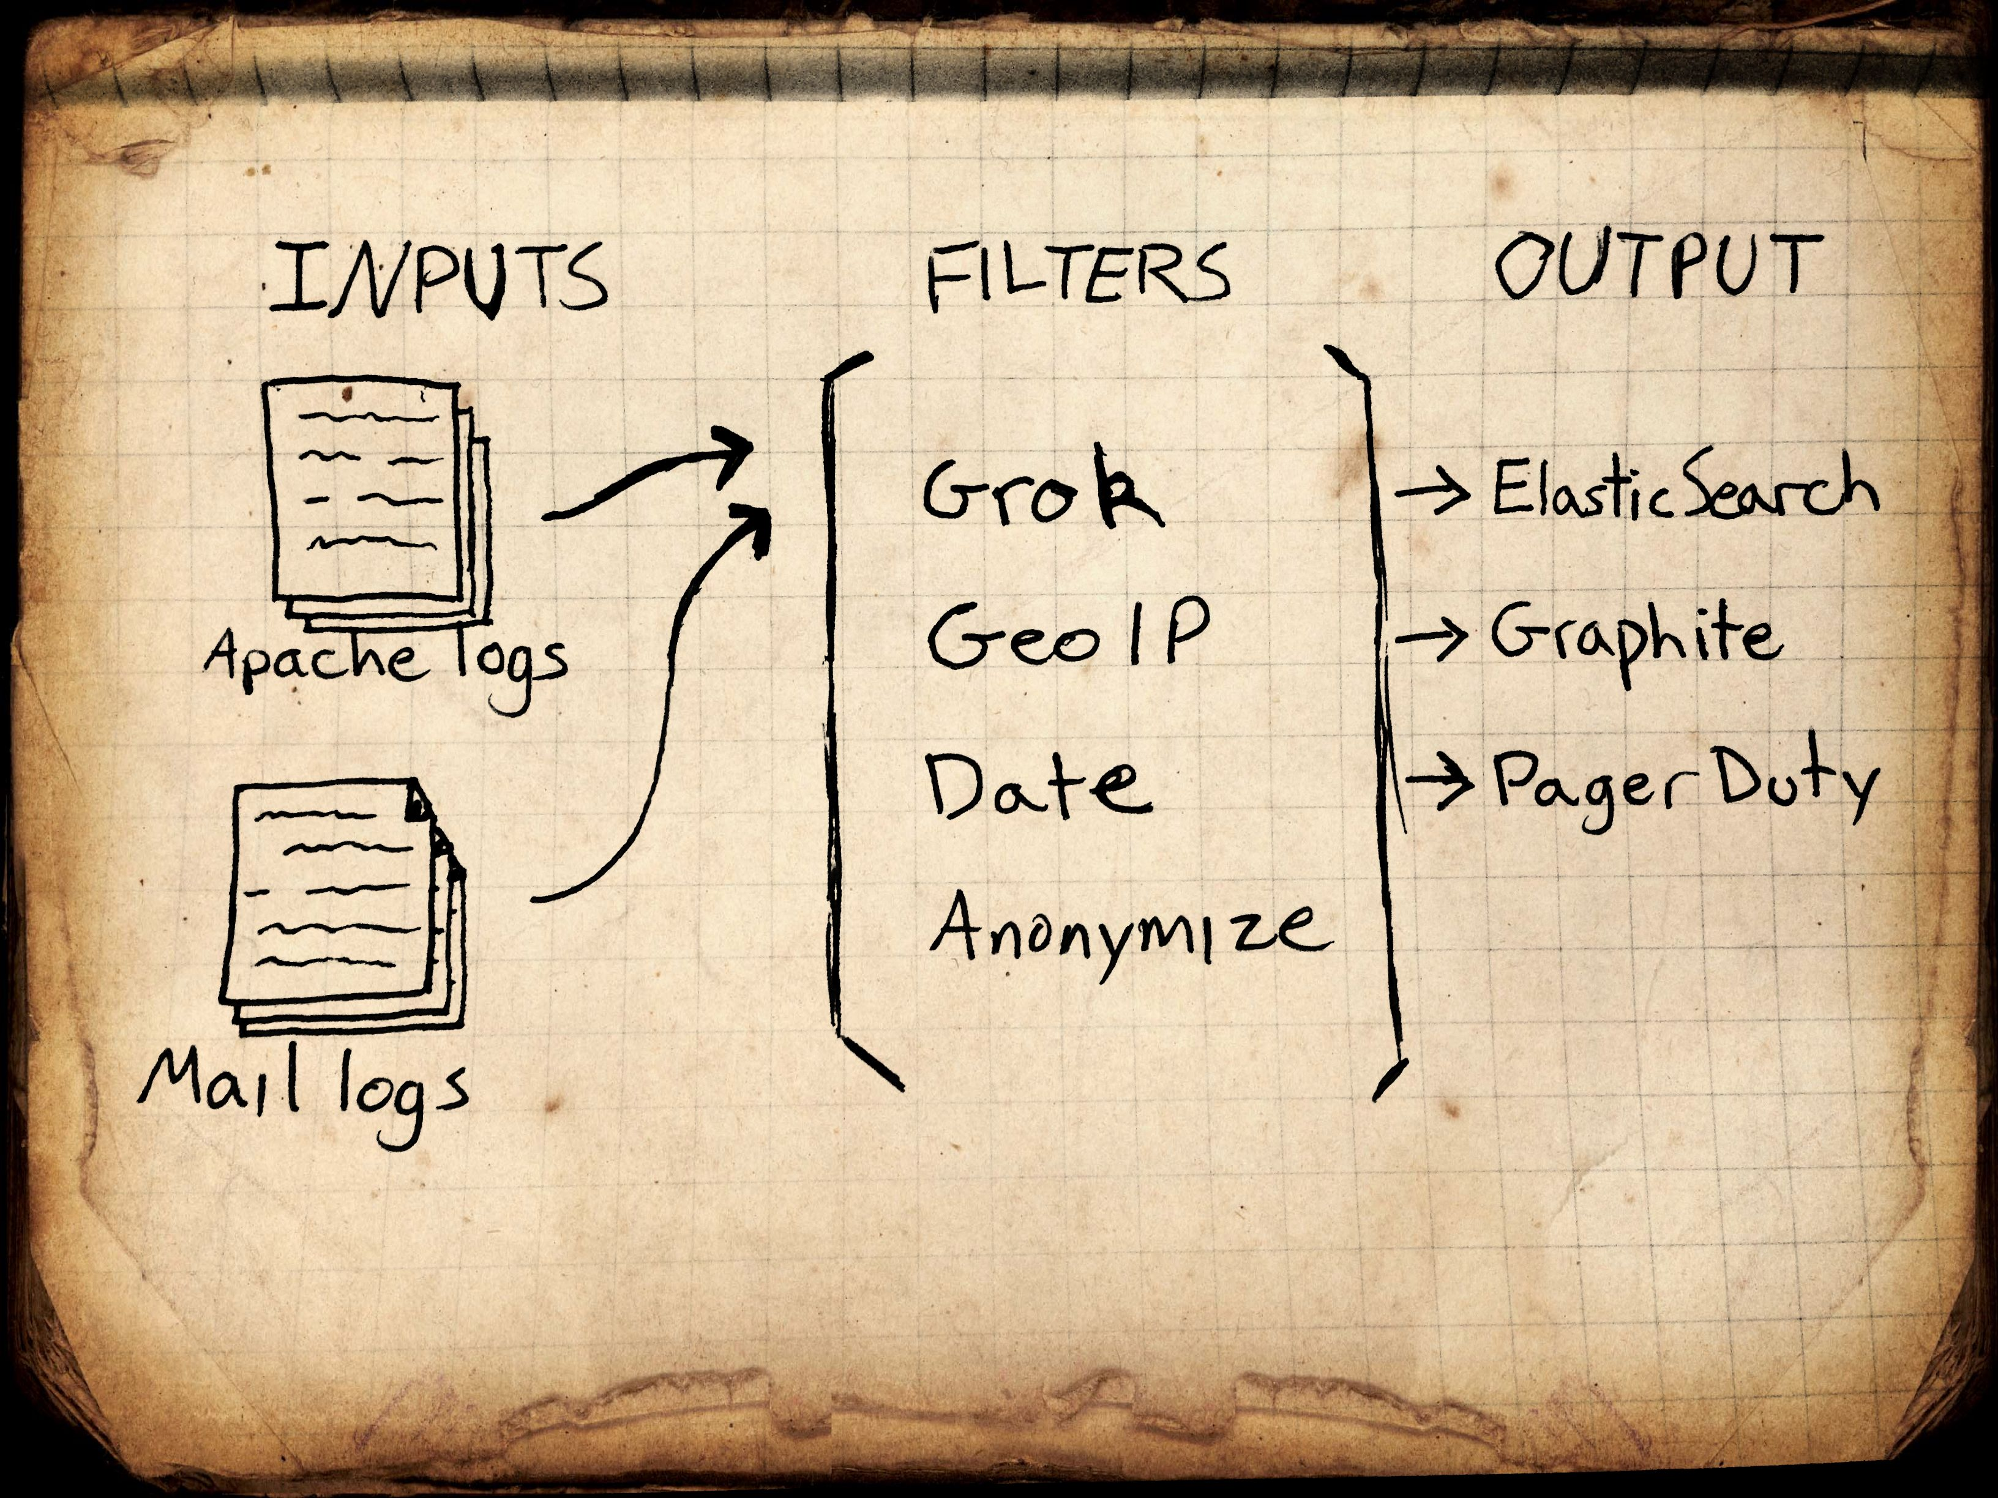
Logstash

Slide 32
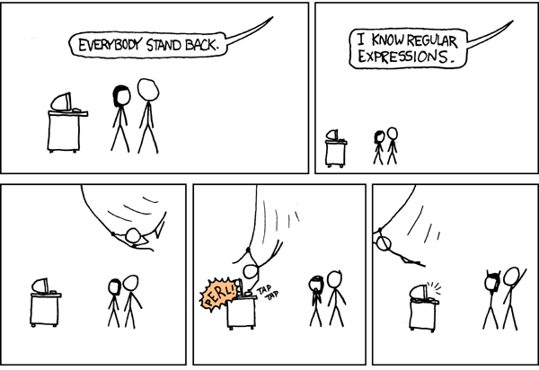
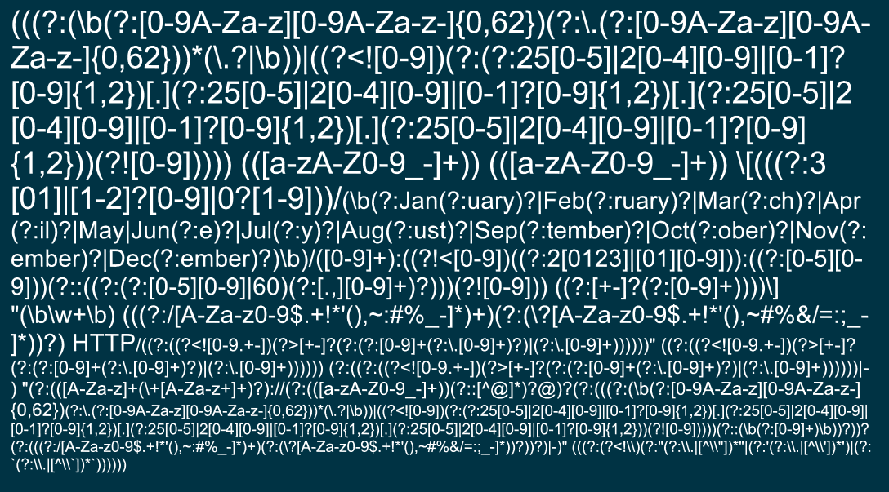
Logstash
Understanding Grok
Why grok?
actual regex to parse apache logs

Slide 33
Logstash
Understanding Grok
•Understanding grok nomenclature.
•The syntax for a grok pattern is %{SYNTAX:SEMANTIC}
•SYNTAX is the name of the pattern that will match your text.
E.g 1337 will be matched by the NUMBER pattern, 254.254.254 will be matched by the IP pattern.
•SEMANTIC is the identifier you give to the piece of text being matched.
E.g. 1337 could be the count and 254.254.254 could be a client making a request
%{NUMBER:count} %{IP:client}

Slide 34
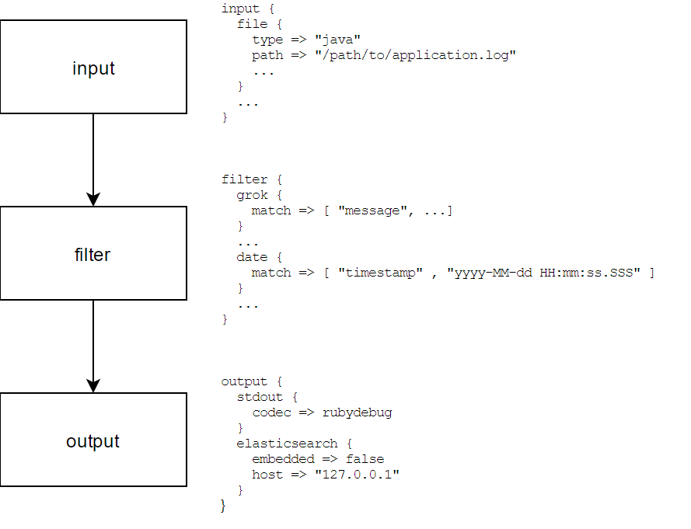
Logstash

Slide 35

Logstash
Processing example
127.0.0.1 - - [05/Feb/2014:17:11:55 +0000] "GET /css/main.css HTTP/1.1" 200 140 "http://www.onet.pl" "Mozilla/5.0 (Windows NT 6.0; WOW64; rv:2.0.1) Gecko/20100101 Firefox/4.0.1"
{
"host" : "127.0.0.1",
"@timestamp" : "2014-02-05T17:11:55+0000",
...
"verb" : "GET"
}

Slide 36
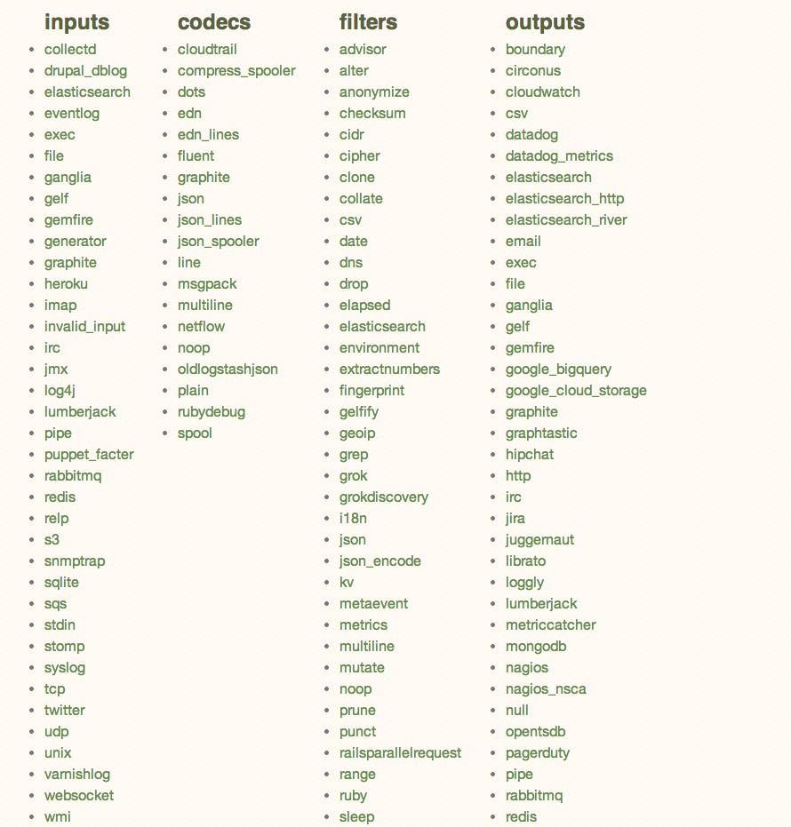
Logstash

Slide 37

Kibana
•Powerful front-end dashboard for visualizing indexed information from elastic cluster.
•Capable to providing historical data in form of graphs,charts,etc.
•Enables real-time search of indexed information.

Slide 38
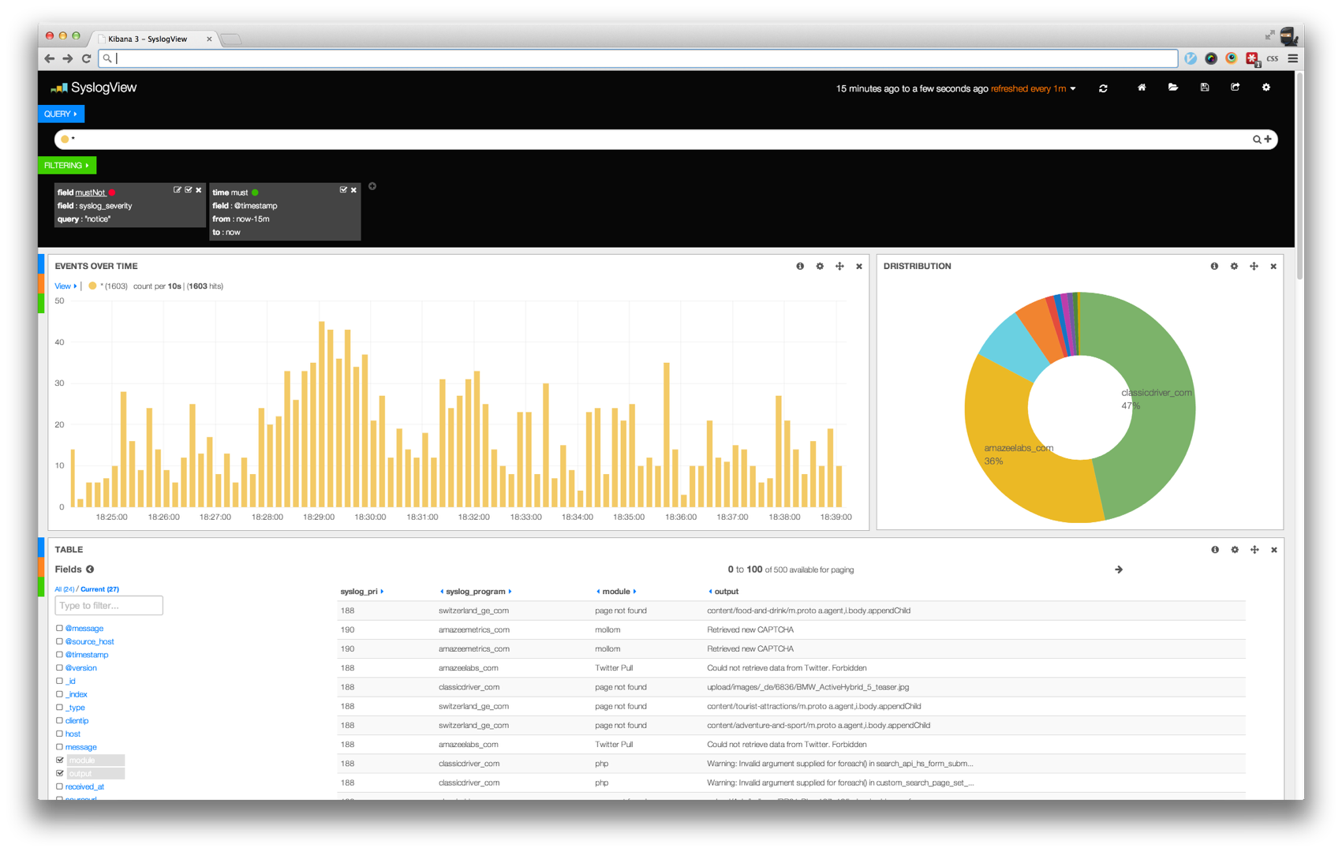
Kibana

Slide 39
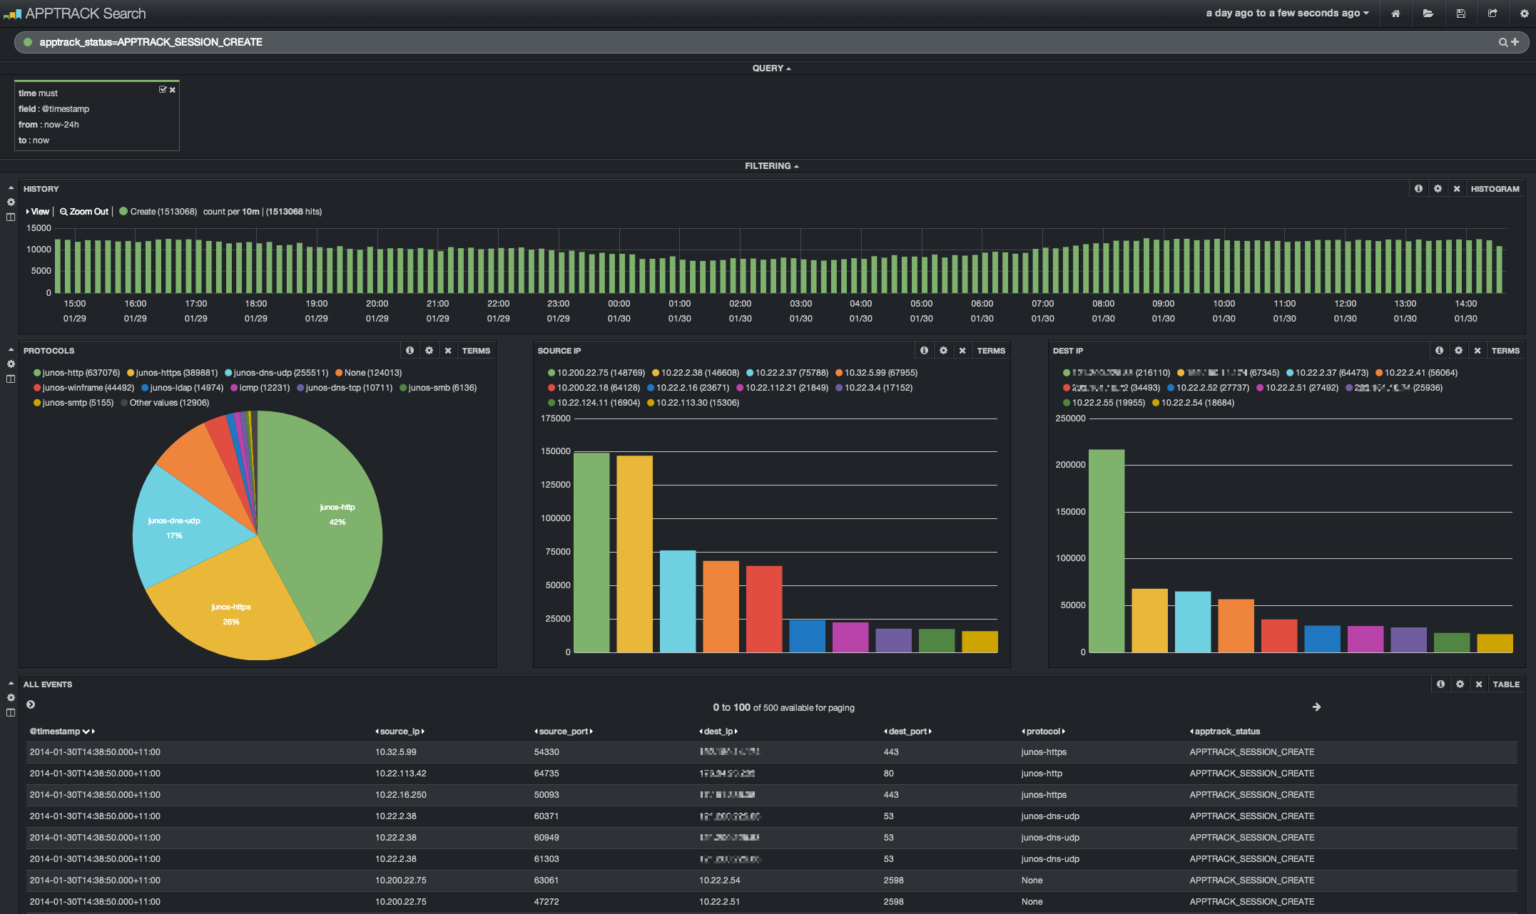
Kibana

Slide 40
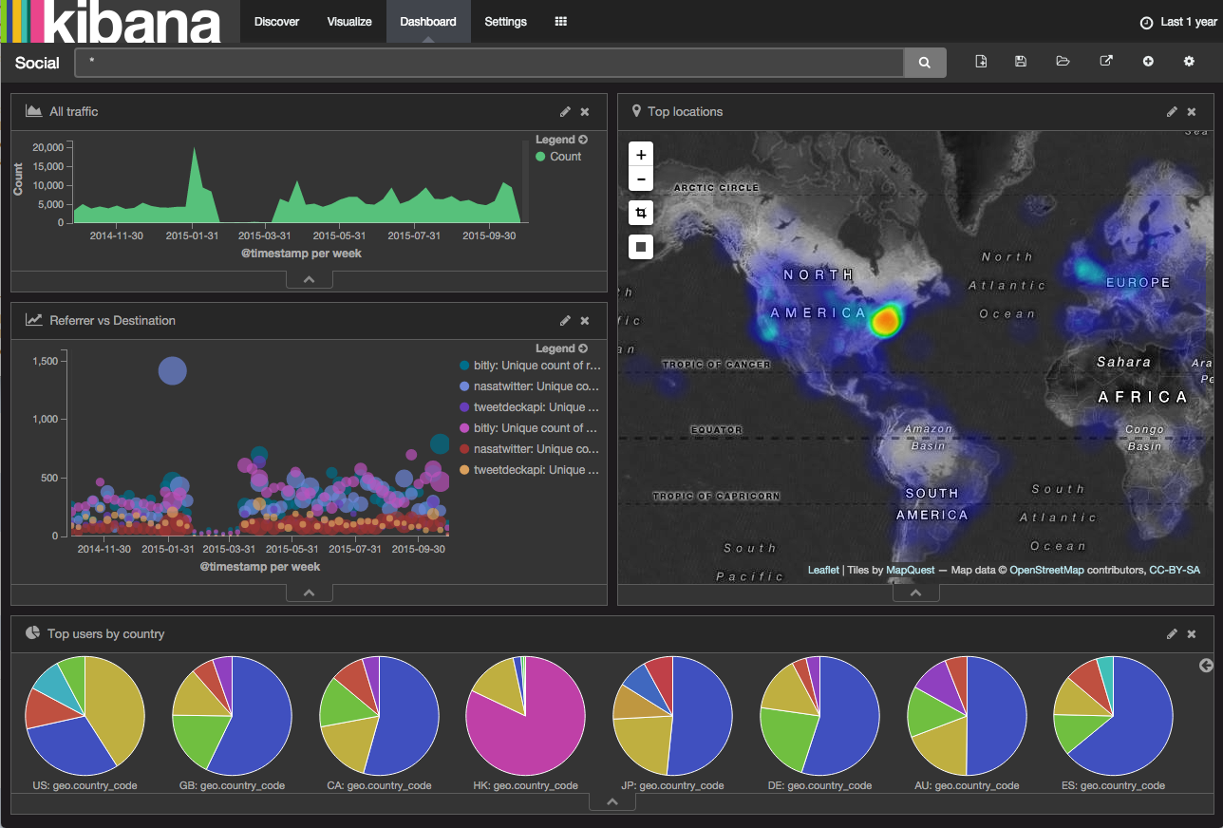
Kibana

Slide 41
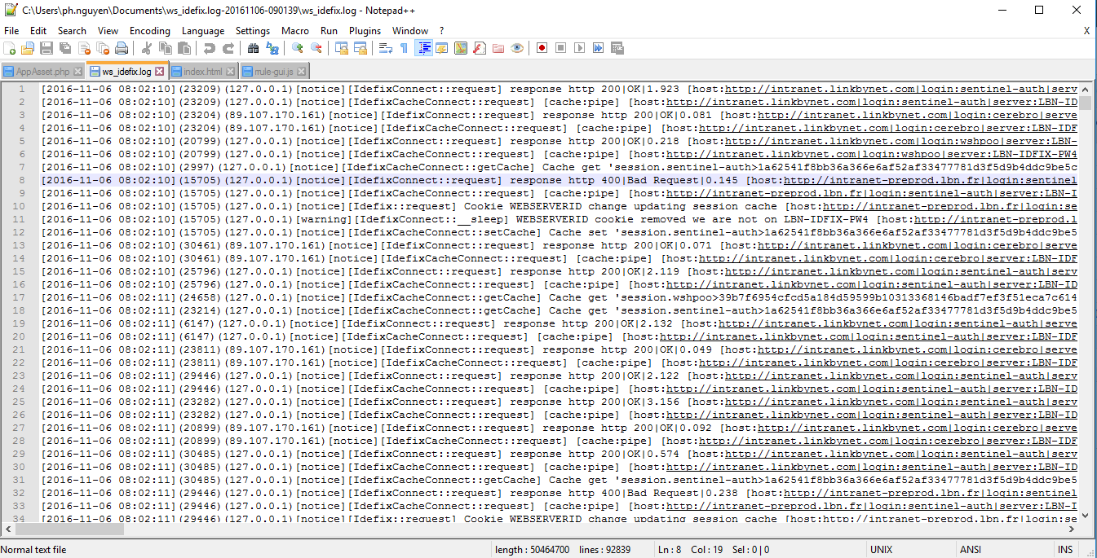
Demo
AAIO Proxy logs

Slide 42
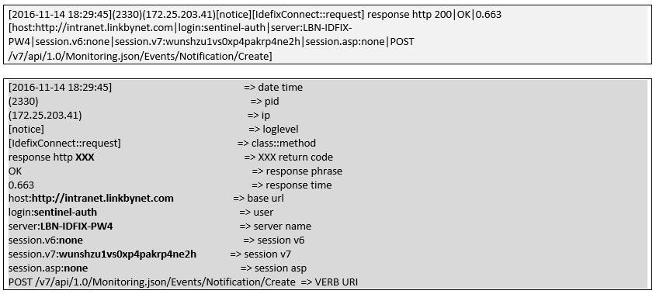
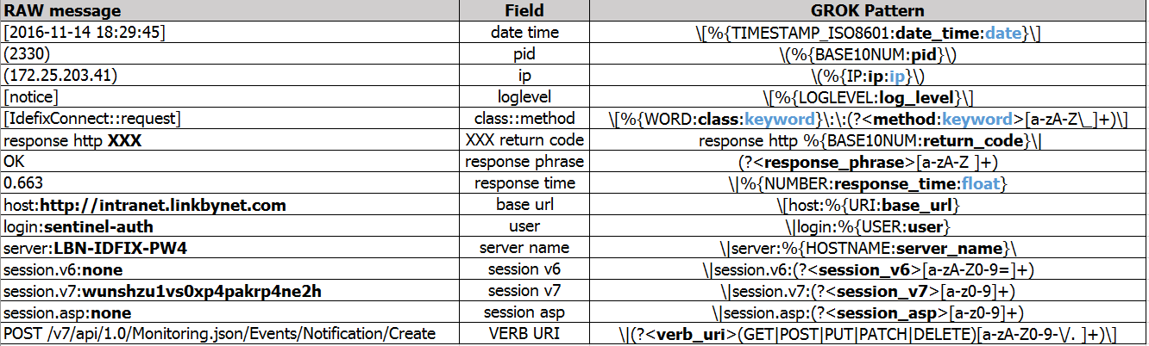
Demo

Slide 43
Demo
"\[%{TIMESTAMP_ISO8601:date_time:date}\]\(%{BASE10NUM:pid}\)\(%{IP:ip:ip}\)\[%{LOGLEVEL:log_level}\]\[%{WORD:class:keyword}\:\:(?<method:keyword>[a-zA-Z\_]+)\] response http %{BASE10NUM:return_code}\|(?<response_phrase>[a-zA-Z ]+)\|%{NUMBER:response_time:float} \[host:%{URI:base_url}\|login:%{USER:user}\|server:%{HOSTNAME:server_name}\|session.v6:(?<session_v6>[a-zA-Z0-9=]+)\|session.v7:(?<session_v7>[a-z0-9]+)\|session.asp:(?<session_asp>[a-z0-9]+)\|(?<verb_uri>(GET|POST|PUT|PATCH|DELETE)[a-zA-Z0-9-\/. ]+)\]"

Slide 44
input {
file {
path => "/tmp/*.log"
start_position => "beginning"
sincedb_path => "/dev/null"
}
}
filter {
grok {
match => {
"message" => [“..GROK..”]
}
}
if "_grokparsefailure" in [tags] { drop {} }
#Predefined date_time
date {
match => [ "date_time", "ISO8601","YYYY-MM-dd HH:mm:ss" ]
target => "date_time"
locale => "en"
}
mutate
{
remove_field => [ "message","host","@version","path","tags","@timestamp" ]
}
}
output {
elasticsearch {
hosts => "https://elasticsearch.com"
ssl => true
index => "logstash-test-01"
}
stdout { codec => rubydebug }
}

Slide 45
Thank you!

